Slide 1
Reading Foundations and Evidence-Based Instructional Practices
Competencies 1 and 2
Module 2, Session 6
Acknowledgements: These materials were prepared by the Florida Center for Reading Research in partnership with the Florida Department of Education, the Just Read Florida! Office, and faculty in the College of Education at Florida State University. The authors would especially like to thank the following faculty and staff for their significant contributions to creating and reviewing materials for this integrated reading endorsement pathway: Mr. Nathan Archer, Ms. Amy Carroll, Dr. Jennifer Gans, Dr. Jennifer Hamilton, Dr. Laurie Lee, Dr. Arzu Leushuis, Ms. Shayla Lightfoot-Brown, Dr. Nicole Patton Terry, Dr. Kevin Smith, and Dr. Kelly Whalon. We acknowledge the authors of the Professional Learning Community materials that support the Foundational Skills to Support Reading for Understanding in Kindergarten Through 3rd Grade*. With those authors' permission, as well as additional resources and materials developed by instructional leaders in Seminole County Public Schools, the same format and five step process for implementing the PLC sessions were utilized for content in Competencies 1 and 2. Permission to reprint or use these materials is required. Inquiries may directed to the Florida Center for Reading Research at fcrr@fcrr.org.
*Kosanovich, M. & Foorman, B. (2016). Professional learning communities facilitator’s guide for the What Works Clearinghouse practice guide: Foundational skills to support reading for understanding in kindergarten through 3rd grade (REL 2016-227). Washington, DC: U.S. Department of Education, Institute of Education Sciences, National Center for Education Evaluation and Regional Assistance, Regional Educational Laboratory Southeast. Retrieved from http://ies.ed.gov/ncee/edlabs.

Slide 2
Culminating Project
A culminating project will provide evidence that teachers are able to apply the knowledge and skills they developed in this course in their classrooms.
Teachers will:
develop and deliver a series of five lessons.
complete a reflection and submit it.
Lesson series will need to include:
appropriate grade level standards
evidence-based instructional practices and activities that promote comprehension, oral language, phonological awareness, phonics, fluency, and vocabulary
whole group and small group lessons
differentiated instruction based on data
assessments that will inform future instruction
A rubric is provided for you to review the culminating projects.

Slide 3
Let’s debrief from the last session by reviewing Activity 3.3!
You implemented the lesson plan you created.
Discuss:
Did you implement the discussion questions and follow-up questions as
planned? If not, describe any adjustments you made and why you made
them.
How did your students respond to your text discussion? Which scaffolds were
effective?
3. Were the student-led structured small-group discussions effective? What
would you change for next time?

Slide 4
Let’s debrief from the last session by reviewing Activity 4.2!
Share your thoughts on the checklist you completed.
Discuss:
How do I choose texts of high quality with richness and depth of ideas and information?
How do I choose texts with word recognition and comprehension difficulty
appropriate for the students’ reading ability and the instructional activity?
How do I select text that supports the purpose of instruction?

Slide 5
Let’s debrief from the last session by reviewing Activity 5.1!
Discuss:
What are some things I did not know before reading about this
recommendation?
Here’s what I’ll do to improve what I’m doing to help my students and mirror
some of the suggestions outlined in the recommendation.
What is the most important thing for me to remember about this
recommendation?

Slide 6
ENGLISH-LEARNER RECOMMENDATIONS

Slide 7
Recommendations
Screen for reading problems and monitor progress.
Provide intensive small-group reading interventions.
Provide extensive and varied vocabulary instruction.
Develop academic English.
Schedule regular peer assisted learning opportunities.

Slide 8
Florida B.E.S.T Standards Connection
Content Covered | BEST Standards Addressed
Comprehension PLC Recommendation 4 – Select texts purposefully to support comprehension development; Recommendation 5 – Establish an engaging and motivating context in which to teach reading comprehension; Teaching English Learners; Assessment and Using Data | ELA Expectations ELA.K12.EE.2.1 Read and comprehend grade-level complex texts proficiently. ELA.K12.EE.4.1 Use appropriate collaborative techniques and active listening skills when engaging in discussions in a variety of situations.

Slide 9
SESSION 6: TEACHING ENGLISH LEARNERS

Slide 10
Review the recommendations in the practice guide to gain an understanding of best practices for teaching English Learners.
Identify classroom practices that are practical applications of the recommendations.
Choose one practice to focus on implementing in your classroom.

Slide 11
Materials
Effective Literacy and English Language Instruction for English Learners in the Elementary Grades practice guide.
Activity 6.1: Review recommendations in the practice guide
Activity 6.2: Reflect and Next Steps

Slide 12
Moving Into New Learning:
Review the recommendations in the practice guide on pages 18-19.
The recommendations are listed and there is a checklist for carrying out the recommendation under each one. These could be considered the “how-to” steps in this practice guide. Some of the steps should be conducted at the district level, some are applicable to the school level, and others can be applied at the classroom level.

Slide 13
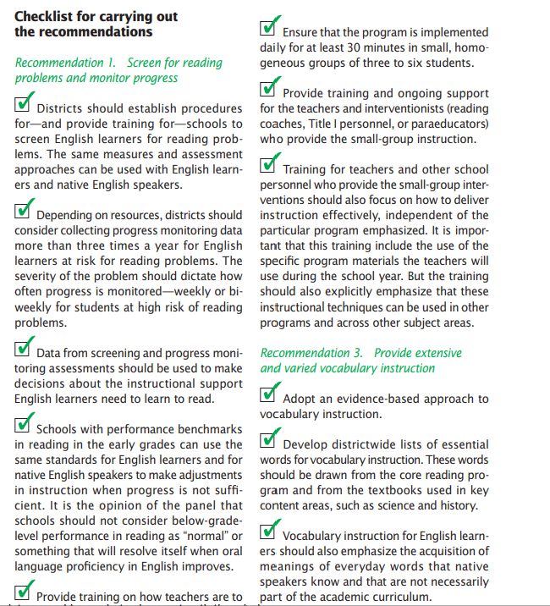
Read through the recommendations and the checklists under each one.
Identify those that should be implemented in the classroom.
Share the ones you have incorporated and those that you may want to address more fully.

Slide 14
Developing Literacy in Second-Language Learners: Report of the National Literacy Panel on Language Minority Children and Youth (report edited by Diane August and Timothy Shanahan)
Teaching language-minority students to read and write well in English is an urgent challenge in the nation's K-12 schools. Literacy in English is essential to achievement in every academic subject - and to educational and economic opportunities beyond schooling. Compounding this challenge are increasing numbers and diversity of language-minority students. Language-minority students who cannot read and write proficiently in English cannot participate fully in American schools, workplaces, or society. They face limited job opportunities and earning power. Inadequate reading and writing proficiency in English relegates rapidly increasing language-minority populations to the sidelines, limiting the nation's potential for economic competitiveness, innovation, productivity growth, and quality of life.

Slide 15
The National Literacy Panel on Language-Minority Children and Youth systematically and rigorously examined the research on acquiring literacy in a second language. Through this process, the panel learned what is known--and what is not yet known--about the complex process of learning to read and write in a second language. Policymakers and educators can use the panel's findings to benchmark their own practices and infuse research-based instruction into literacy programs for language-minority students. Researchers can enrich this knowledge base by focusing on the specific gaps in our knowledge, which in the future will enable U.S. schools to better educate English-language learners in English literacy.

Slide 16
Unlocking the research on English learners (article by Claude Goldenberg in Education Digest)
Four important principles based in the research include:
Generally effective practices are likely to be effective with ELs.
ELs require additional instructional supports.
The home language can be used to promote academic development.
ELs need early and ample opportunities to develop proficiency in English.

Slide 17
Generally effective practices for non-ELs are likely to be effective with ELs.
There is a vast literature on effective teaching practices. Educational research has yielded a number of reasonably consistent findings about the features of teaching likely to result in improved student learning.
These include:
Clear goals and objectives
Appropriate and challenging material
Well-designed instruction and instructional routines
Clear instructions and supportive guidance as learners engage with new skills
Effective modeling of skills, strategies, and procedures

Slide 18
Continued:
Active student engagement and participation
Informative feedback to learners
Application of new learning and transfer to new situations
Practice and periodic review
Structured, focused interactions with other students
Frequent assessments, with reteaching as needed
Well-established classroom routines and behavior norms
There seems to be considerable overlap between what is effective instruction for ELs and what is effective for students already proficient in English.

Slide 19
ELs require additional instructional supports.
ELs in an English instructional environment will almost certainly need additional supports so that instruction is meaningful and productive. Aside from the pedagogical need, there is also the legal requirement mandated by the Supreme Court’s decision in Lau v. Nichols (1974) that classroom instruction must be meaningful to students even if their English language proficiency is limited. The need for additional supports is particularly true for instruction aimed at higher-level content and comprehension of academic texts.

Slide 20
One of the most important findings of the National Literacy Panel on Language-Minority Children and Youth was that the effects of reading instruction on ELs’ reading comprehension were uneven and often nonexistent even when comprehension skills were taught directly. This is in contrast to studies with English-proficient students, for whom reading instruction helps improve reading comprehension. Why does improving reading comprehension for English learners instructed in English appear so elusive? A likely explanation is that lower levels of English proficiency interfere with comprehension and can blunt the effects of otherwise sound instruction.
The article found that instructional conversations had no overall effect on ELs’ story comprehension— students in both groups understood the story about equally. They did find that instructional conversations produced deeper understandings of a complex concept at the heart of a story the students read, but this is different from story comprehension.

Slide 21
The article looked at the results for students with different English proficiency levels and they found something striking: for the students with the highest English proficiency, participation in instructional conversations did have an impact on story comprehension—91 percent accuracy versus 73 percent accuracy for students in the comparison group. The middle-level students also did better with instructional conversations, but the results were not statistically significant. The lowest-level English speakers did worse with instructional conversations, although also not to a statistically significant degree.
These results suggest that instruction aimed at improving ELs’ comprehension is likely to be more effective when ELs have relatively higher English skills, but less effective, ineffective, or even possibly counterproductive when their English skills are lower.

Slide 22
Educators and researchers have proposed a set of instructional supports or modifications that are sometimes referred to as sheltered instruction. The goal of sheltered strategies is to facilitate the learning of grade-level academic content and skills for students being instructed in English but who have limited proficiency in the language. Sheltered instruction can be expected to contribute to English language development, but its real focus is academic content and skills.
Some of the supports and modifications that have been proposed for instructing ELs include:
• Building on student experiences and familiar content (then adding on material that will broaden and deepen students’ knowledge)
• Providing students with necessary background knowledge

Slide 23
Continued:
• Using graphic organizers (tables, web diagrams, Venn diagrams) to organize information and clarify concepts
• Making instruction and learning tasks extremely clear
• Using pictures, demonstrations, and real-life objects
• Providing hands-on, interactive learning activities
• Providing redundant information (gestures, visual cues)
• Giving additional practice and time for discussion of key concepts
• Designating language and content objectives for each lesson
• Using sentence frames and models to help students talk about academic content
• Providing instruction differentiated by students’ English language proficiency

Slide 24
The problem with this proposed set of instructional supports is that there is not much evidence that these strategies actually help English learners overcome the challenges they face in learning advanced academic content and skills, as they will be required to do with grade level standards. There are virtually no data to suggest that sheltered instruction or any of these modifications and supports help ELs keep up with non-ELs or help close the achievement gap between them.
For some of the items on the list, such as the use of content and language objectives, sentence frames, and differentiating instruction by English proficiency levels, there are no published data at all about their effects on ELs’ learning.

Slide 25
Even the most popular sheltered model in existence and one that brings together many different elements into a useful and coherent instructional model—the Sheltered Instruction Observation Protocol (SIOP)—has yet to demonstrate more than a very modest effect on student learning.
The most recent study found modest effects that were not statistically significant.
However, there is some evidence that these supports and modifications do benefit ELs. For example, studies reviewed by the National Literacy Panel on Language-Minority Children and Youth find that building on students’ experiences and using material with familiar content can facilitate ELs’ literacy development and reading comprehension.

Slide 26
It is generally true that what we know and are already familiar with can influence new learning and the comprehension of what we read. Teachers should therefore use materials with some degree of familiarity to students. If students are expected to read material with unfamiliar content, it is important to help them acquire the necessary background knowledge. Building background knowledge or building on prior experience and familiar content might be especially important for ELs, since they face the double challenge of learning academic content and skills as they learn the language of instruction.
There is also substantial literature on graphic displays and organizers, which facilitate and support learning by clarifying content and making explicit the relationships among concepts.

Slide 27
One team of researchers taught students explicitly about the science inquiry method by using pictures to illustrate the process, employing multiple modes of representation (for example, verbal, gestural, graphic, or written), and incorporating students’ prior linguistic and cultural knowledge into the instruction. Another team built its intervention around the topic of immigration, which presumably had considerable resonance for the ELs, who were themselves immigrants or whose parents were immigrants from Latin America or the Caribbean.
This team also used supports in the home language. While both programs showed positive effects on student learning, neither study found any difference in learning outcomes for ELs and non-ELs.

Slide 28
One recent study represents a new development. The researchers found that “multimedia-enhanced instruction” (videos used as part of lessons) helped make read-aloud vocabulary instruction more effective for ELs in preschool to second grade but had no effect on the learning of non-ELs.
Teachers used videos related to the topics in books they read aloud to their students as part of the science curriculum on habitats (for example, coral reefs or deserts).
The ELs who saw the videos as part of the vocabulary instruction learned more of the target words and made greater gains on a general vocabulary measure than those who did not. The videos helped either greatly diminish or eliminate the gap between ELs and non-ELs on the target words. This suggests a potentially very effective strategy that improves ELs’ vocabulary learning while not compromising the learning of students already proficient in English.

Slide 29
In short, we have many promising leads but not a very good understanding of how to help ELs learn high-level academic content and skills despite limited English proficiency.
What one researcher wrote about instruction focusing on language in addition to academic content—“the published research is at an early stage”—is equally true for other supports intended to help ELs achieve at high academic levels.

Slide 30
The home language can be used to promote academic development.
The most controversial topic in instructing ELs is the role of the home language.
There are two aspects to the issue:
teaching academic content and skills, such as reading and mathematics, in the home language
using the home language as support in an otherwise all-English instructional environment—for example, providing definitions or brief explanations in the home language, but keeping instruction overwhelmingly in English

Slide 31
Teaching academic skills in the home language is at the core of the great “bilingual education” debate. Proponents of bilingual education have long argued that students should be taught in their home language (although certainly not exclusively) and that doing so strengthens the home language and creates a more solid foundation for acquiring academic skills in English.
Opponents of bilingual education argue that instruction in a student’s home language is a waste of time, depresses achievement in English, and simply delays an EL’s entrance into the academic (and social) mainstream.
These debates over bilingual education are typically framed in terms of outcomes in English. English outcomes are without a doubt important, but there is an additional reason to consider primary language instruction for English learners, and that is the inherent advantage of knowing and being literate in two languages.

Slide 32
No one should be surprised to learn that all studies of bilingual education have found that teaching children in their primary language promotes achievement in the primary language.
If primary language achievement comes at the expense of achievement in English, this might not be a worthwhile tradeoff. However, bilingual education tends to produce better outcomes in English; at worst, it produces outcomes in English equivalent to those produced by English immersion. In other words, bilingual education helps students become bilingual - something that is valuable for anyone, not just ELs.

Slide 33
Numerous experimental studies show that learning to read in their home language helps ELs boost reading skills in English. Learning to read in the home language also maintains home language literacy skills.
Five meta-analyses reached the same conclusion - bilingual education produced superior reading outcomes in English compared with English immersion.
Further research has been conducted that support both sides of this debate, as well as, disagree with both sides of this debate. Ultimately, quality of instruction and curriculum and the school supports needed to support them are more important determinants of ELs’ achievement than language of instruction.

Slide 34
The home language can be used to support learning in an English instructional environment in the following ways:
• Cognates (words with shared meanings that have common etymological roots, such as geography and geografia)
• Brief explanations in the home language (not direct concurrent translations, which can cause students to “tune out” while English is being spoken)
• Lesson preview and review (lesson content is previewed in students’ home language to provide some degree of familiarity when the lesson is taught; following the lesson, there is a review in the home language to solidify and check for understanding)
• Strategies taught in the home language (reading, writing, and study strategies are taught in the home language but then applied to academic content in English)

Slide 35
Educators cannot wait until researchers have adequately solidified our understanding of how to help ELs meet the content and language challenges they face. They’ll be waiting a long time. In the meantime, at the very least we must provide all possible supports.
We must create settings in schools where teachers have the time and space to:
Systematically study with colleagues the standards or learning goals teachers are expected to follow
• Specify and articulate what these standards and goals mean for curriculum and instruction in their classrooms
• Implement curriculum, and plan and carry out instruction, based on these understandings

Slide 36
Continued:
• Systematically collect student work indicating student progress toward desired outcomes
• Analyze and evaluate student work with colleagues to help determine what is working and what is not
• Repeat the above continuously and systematically, throughout and across school years
Putting these in place is no simple matter. It will require school-wide, concerted, and coherent efforts made possible by leadership, accountability, support, and assistance. Even with all this in place, there are no guarantees that we can accomplish the very ambitious and worthwhile goals we have set for ourselves and our students.

Slide 37
Reading Comprehension Skills for English Learners (from Colorin Colorado)
English Learners often have problems mastering science, math, or social studies concepts because they cannot comprehend the textbooks for these subjects. ELs at all levels of English proficiency, and literacy, will benefit from explicit instruction of comprehension skills along with other skills.
Examples of comprehension skills that can be taught and applied to all reading situations include:
Summarizing Sequencing Inferencing
Comparing and contrasting Drawing conclusions Self-questioning
Problem-solving Relating background knowledge
Distinguishing between fact and opinion Main Idea and Supporting Details
These skills are particularly important for comprehending informational texts.

Slide 38
Classroom Strategies: Steps for Explicitly Teaching Comprehension Skills
The following steps are useful for all students. However, these need to be complemented with the additional steps (on the next slide) to ensure comprehension for ELs.
Introduce the comprehension strategy or skill through examples. Discuss how, when, where, and why the strategy or skills are used. For example: contrast main idea with details, fact with opinion, good summaries with poor summaries.
Have students volunteer additional examples to contrast and discuss.
Label, define, model, and explain the strategy or skill. For example, after listing four facts about a healthy diet and four opinions about what is good to eat, label one list as facts and the other list as opinions.
Give students opportunities to practice using the strategy with a peer as they apply it to a short, simple paragraph from a science text or any expository text.
Debrief with the whole class to ask students to share how they applied the strategy or skill.

Slide 39
Additional Steps for ELs:
Identify vocabulary words that you think might be difficult for students to understand when they read the text. Write EL-friendly definitions for each - that is, simple, brief definitions ELs can easily understand.
Model think-alouds. For example: verbalize a confusing point or show how you use a strategy to comprehend something. "This sounds very confusing to me. I better read this sentence again."
Demonstrate fix-up strategies. For example: I need to think about this. Let me rethink what was happening. Maybe I'll reread this. I'll read ahead for a moment.
Partner ELs with more dominant English speakers and ask each student to take a turn reading and thinking aloud with short passages.
Celebrate each ELs' progress with recognition notes, praise, and/or class applause.

Slide 40
For Advanced ELs:
When students' English proficiency and basic reading skills have increased, you can teach the following steps not just to ELs, but to all students – because everyone will benefit.
In pairs, have students survey the text and use an idea map to record the main idea and details.
Ask partners to read the text.
Have partners restate the main idea and supporting details. At this point, they can add to their idea map or make necessary corrections.
Then ask students to reread the text and either develop their own questions (pretending to prepare a test for their partner) or write a short summary of what they just read.
After that, have partners check each other's work.
Finally, partners can share their questions or summaries with other teams.

Slide 41
Other Ideas For Building EL Comprehension:
Teach students how to use these tools for informational or expository reading:
Titles Headings Bold print Captions
Side bars Maps Graphs Pictures
Bullets
Ask students to use the following strategies to summarize (orally or in writing):
Retell what you read but keep it short. Include only important information.
Leave out less important details. Use key words from the text

Slide 42
Question ELs After Reading:
After the ELs and/or whole class have completed the reading comprehension activities above, you can anchor or test their comprehension with carefully crafted questions, taking care to use simple sentences and key vocabulary from the text they just read.
These questions can be at the:
Literal level (Why do the leaves turn red and yellow in the fall?)
Interpretive level (Why do you think it needs water?)
Applied level (How much water are you going to give it? Why?)

Slide 43
Potential Obstacles for Implementing Recommendation 1
Review the potential roadblock to implementing Recommendation 1. Read the panel’s advice on page 12-13.
Roadblock 1.1- Some teachers believe that reading problems may resolve themselves once English learners develop proficiency in oral English. So, they are hesitant to refer these students for additional assistance or to provide intensive instruction in foundational areas of beginning reading.
Roadblock 1.2- Some teachers may feel that it is unfair to test a child in a language that she or he does not understand.
Roadblock 1.3- Some teachers may feel that native language assessments are more valid than English language measures for this group of students.

Slide 44
Potential Obstacles for Implementing Recommendation 1
Review the potential roadblock to implementing Recommendation 1. Read the panel’s advice on page 12-13.
Roadblock 1.4- Districts should anticipate that schools will have a tendency to view data collection as the terminal goal of conducting formative assessments, especially early in the process.
Roadblock 1.5- In districts that have the same early reading goals and standards for English learners and non-English learners, it is likely that the current performance of many English learners will be below these standards.
Roadblock 1.6- Teachers may focus too much on what is tested—phonemic skills, decoding ability, and oral reading fluency—and neglect instruction in comprehension and vocabulary.
Discuss obstacles you have experienced and ways in which you overcame them.

Slide 45
Potential Obstacles for Implementing Recommendation 2
Review the potential roadblock to implementing Recommendation 2. Read the panel’s advice on page 17-18.
Roadblock 2.1- Teachers may be uncomfortable identifying students for additional reading instruction if their English language skills are low.
Roadblock 2.2- Students already are pulled out of class for other services (such as speech, English language development, or English as a second language). Pulling students out for additional reading instruction makes their instructional day too fragmented.
Roadblock 2.3- Students will miss valuable instructional time in other areas.

Slide 46
Potential Obstacles for Implementing Recommendation 2
Review the potential roadblock to implementing Recommendation 2. Read the panel’s advice on page 17-18.
Roadblock 2.4- Arranging a building-level or grade-level schedule that allows for additional small-group instruction is a complex process. Individual teachers may feel that they do not have the time or resources to provide additional small-group instruction to these students.
Discuss obstacles you have experienced and ways in which you overcame them.

Slide 47
Potential Obstacles for Implementing Recommendation 3
Review the potential roadblock to implementing Recommendation 3. Read the panel’s advice on page 21-22.
Roadblock 3.1- Teaching vocabulary effectively is difficult. Many teachers will struggle learning how to provide effective vocabulary instruction to English learners.
Roadblock 3.2- Some teachers may incorrectly assume that English learners know a concept and the word for that concept in their primary language—when, in fact, they do not. This is particularly true for technical terms encountered in science, geography, and history. If students do not know the concept in their primary language, the Panel suggests teaching the word directly in English.
Discuss obstacles you have experienced and ways in which you overcame them.

Slide 48
Potential Obstacles for Implementing Recommendation 4
Review the potential roadblock to implementing Recommendation 4. Read the panel’s advice on page 26-27.
Roadblock 4.1- Some educators may want to cushion their English learners, believing that academic English is too hard for them to develop or that the expectations are too demanding.
Roadblock 4.2- There may not be enough time in the instructional day to provide English learners with sufficient instruction on the features of academic English.
Roadblock 4.3- Many teachers fail to link vocabulary instruction to instruction on proper language usage.
Discuss obstacles you have experienced and ways in which you overcame them.

Slide 49
Potential Obstacles for Implementing Recommendation 5
Review the potential roadblock to implementing Recommendation 5. Read the panel’s advice on page 29.
Roadblock 5.1- Some teachers may feel that the added time required by English learners may take instructional time away from other students.
Roadblock 5.2- Teachers may be concerned about the time it takes to teach students the routines.
Roadblock 5.3- Teachers may be concerned that this takes time away from instruction.
Discuss obstacles you have experienced and ways in which you overcame them.

Slide 50
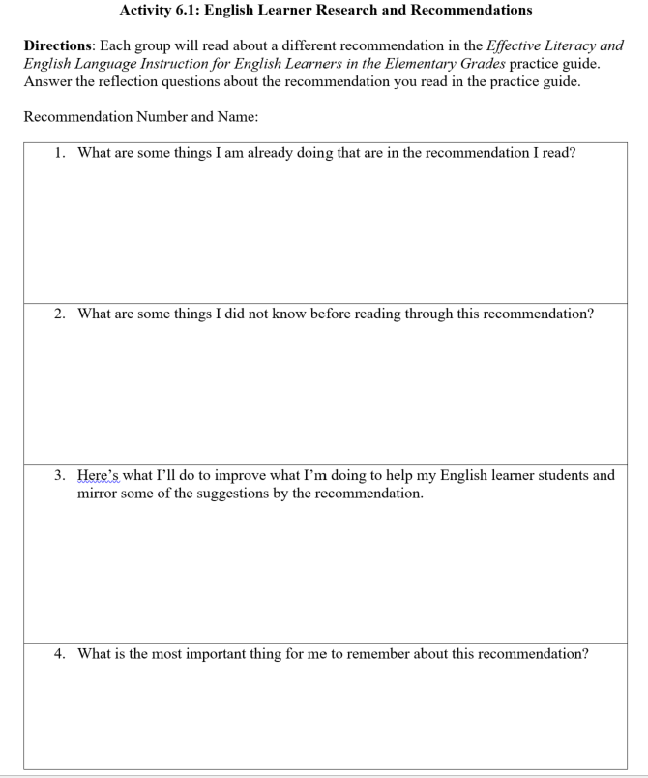
Work in small groups of two or three.
Choose one recommendation that your group would like to read thoroughly and discuss.
Complete Activity 6.1: English Learner Research and Recommendations.
Recommendation 1 – Screen for reading problems and monitor progress (pgs. 9-14)
Recommendation 2 – Provide intensive small-group reading interventions (pgs. 15-18)
Recommendation 3 – Provide extensive and varied vocabulary instruction (pgs. 19-22)
Recommendation 4 – Develop academic English (pgs. 23-27)
Recommendation 5 – Schedule regular peer-assisted learning opportunities (pgs. 28-30)

Slide 51
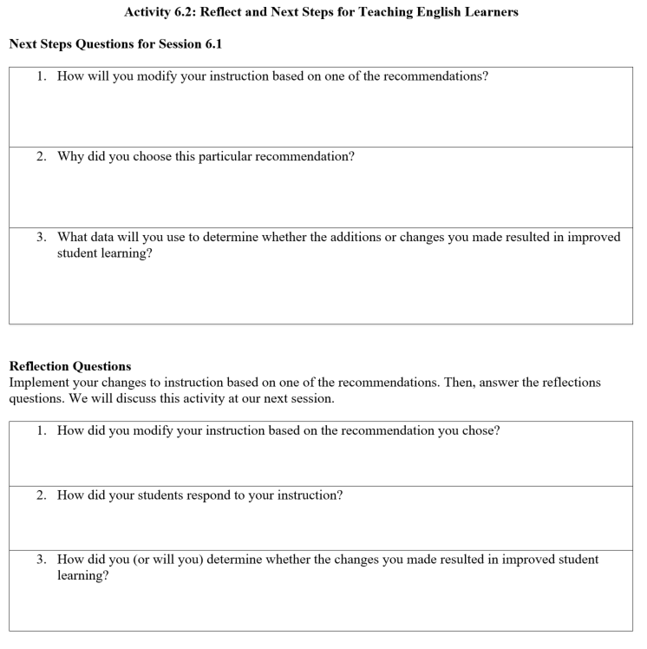
Reflect:
Discuss:
What are some things you are already doing that are in the recommendation your group read?
What are some things your group did not know before reading the recommendation?
What are some practices in the recommendation that you might incorporate into your instruction?
What does your group consider the most important thing to remember about this recommendation?

Slide 52
Implement:
Modify your reading instruction based on one of the recommendations in the practice guide. Perhaps you will increase the emphasis on vocabulary, focus more on developing academic English, or dedicate time for peer-assisted learning opportunities. Even if you do not serve English learners, incorporating practices related to these areas can be helpful to all students.
Complete Activity 6.2.
Be ready to share your experiences in the next session.

Slide 53
At the start of the next PLC session, be prepared to respond to the following:
1. How did you modify your instruction based on the recommendation you chose?
2. How did your students respond to your instruction?
3. How did you (or will you) determine whether the changes you made resulted in improved student learning?

