Slide 1
Guide for Identifying Evidence-Based Interventions for School Improvement
Professional Learning Module for Training Self-Study Facilitators
Notes:
Purpose: This professional learning module is designed to help participants become aware of the purpose of the Guide for Identifying Evidence-Based Interventions for School Improvement, become acquainted with the guide itself, and familiarize themselves with their role as a facilitator. While it is possible that the module could be utilized to train facilitators of a state-level team, it is more likely that prospective facilitators of local or school-based self-study teams would benefit most from this module.
Delivery: The intention is that the module be delivered face-to-face.
Deliverer of the module: Leader in a state or local education agency
Audience: Prospective facilitators of self-study teams at the state or local level using the SEA or LEA Guide for Identifying Evidence-Based Interventions for School Improvement.
Approximate time for module: 3.5 hours.

Slide 2
Agenda
Welcome and Housekeeping
The goal of this session is to enable participants to serve as effective facilitators of a self-study in their agency, district, or school, utilizing the Guide of identifying Evidence-Based Interventions for School Improvement.
Content for the Session:
ESSA and the Guide for Identifying Evidence-Based Interventions for School Improvement
The Self Study Process
Conducting Self-Study
Exploring the Guide and the Role of the Facilitator
Reflection and Summary
Notes:
5 min. – Welcome participants and provide them with information regarding the session such as timing of breaks, encouragement to place phones on “silent,” location of the restrooms, etc. Post chart paper as a “parking lot” for questions so participants may write questions on sticky notes and post them throughout the session. You may choose to answer questions along the way, or save them to the end. Review the goal and the components of the session.

Slide 3
ESSA and the Guide for Identifying Evidence-Based Interventions for School Improvement

Slide 4
Requirements of ESSA – Schools in Need of Comprehensive Support
States must notify each local educational agency (LEA) in the State of any school that is identified for comprehensive support
Each notified LEA must in partnership with stakeholders, develop an improvement plan that:
Includes long-term goals for student performance
Includes evidence-based interventions
Is based on a school-level needs assessment
Identifies resource inequities
Is approved by the school, LEA, and the State education agency
Is monitored and periodically reviewed by the SEA
Notes:
2-3 minutes – Review the requirements of ESSA with the participants. Reflect that this information is taken from Section 1003 of ESSA (pg. 40). http://www2.ed.gov/documents/essa-act-of-1965.pdf.

Slide 5
Requirements of ESSA – Schools in Need of Targeted Support
States must notify each local educational agency (LEA) in the State of any school served by the local educational agency in which any subgroup of students is consistently underperforming
LEAs must notify schools with respect to which subgroup of students in such school are consistently underperforming
Each notified school must in partnership with stakeholders, develop an improvement plan that:
Includes long-term goals for student performance
Includes evidence-based interventions
Is approved by the LEA
Is monitored by the LEA
Results in additional action following unsuccessful implementation of such plan after a number of years determined by the LEA.
Notes:
2-3 minutes – Review the requirements of ESSA with the participants. Reflect that this information is taken from Section 1003 of ESSA – pg. 42.
http://www2.ed.gov/documents/essa-act-of-1965.pdf

Slide 6
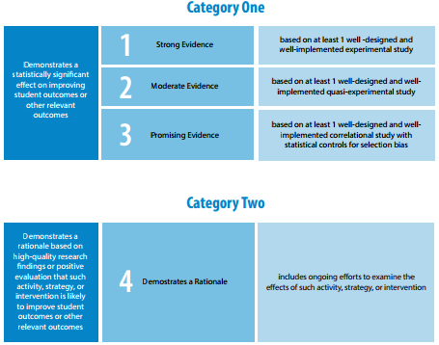
ESSA – Levels of Evidence
Notes:
1-2 minutes – Review the ESSA levels of evidence with the participants including the fact that school improvement funds must be used only for interventions that fall in the first three levels. Explain that we will be examining these more in depth later in the session.

Slide 7
What is the Purpose of the Guide?
The Guide for Identifying Evidence-Based Interventions for School Improvement is intended to help SEAs and LEAs carefully consider the evidence supporting intervention options that they will require or recommend in their state ESSA plan, school improvement plans, and funding applications. SEAs could indicate in their state ESSA plan how they have used or will use the self-study process to identify interventions, in partnership with stakeholders.
Notes:
1-2 min. – Explain that this is the overarching purpose of the guide and that the guide was developed to help SEAs and LEAs to evaluate evidence as this had not been a requirement in the past. Remind participants that state or local agencies may reflect in their school improvement plans or ESSA plan the fact that they have engaged in the self-study process, which is systematic and thorough, in an effort to choose the most appropriate interventions with the highest evidence base.

Slide 8
What are the Goals of the Guide?
The purpose of the guide is to help self-study teams:
Evaluate the evidence base for interventions that may be considered for use in schools in need of comprehensive or targeted support
Determine the interventions that have strong evidence and are relevant and appropriate to meeting the needs of schools
Plan to provide resources for schools to help them choose or implement interventions.
Notes:
1-2 min. – Explain that these goals are delineated in the guide. Remind the participants that It is the responsibility of the LEAs and, ultimately, the SEAs to select and implement evidence-based interventions that will positively impact student achievement. In order for that to happen, these goals must be achieved.

Slide 9
How Does the Guide Help?
The guide provides the following to help self-study teams meet their goals:
A process for a variety of stakeholders to be involved in decision-making through their participation on the self-study team
A structure for focused and thoughtful conversations
A variety of tools to record the thoughts of the self-study team regarding selection of interventions and planning for successful implementation
A procedure for decision-making and follow-through
Notes:
1-2 min. – Explain to the participants that to meet the goals on the slide, the self-study team must approach them systematically. Note that the guide helps them to do this work by providing a framework and tools, and the facilitator is integral to the leading the team through the process to reach the goals.

Slide 10
School Improvement Opportunities Under ESSA
Choice – States and LEAs may select interventions they deem best for their schools in need of comprehensive or targeted support.
Flexibility – ESSA provides the following flexibility to states:
create a list of evidence-based interventions for schools in need of comprehensive or targeted support from which local education agencies (LEAs) must choose
allow LEAs to select evidence-based school improvement interventions themselves
Choice and Flexibility may lead schools to implement interventions that are targeted to their needs and have the strongest level of evidence-base possible, thereby improving student achievement.
Notes:
1-2 min. – Discuss with the participants that It is important to recognize that ESSA provides opportunities for states, LEAs, and schools to use their best judgment when it comes to selecting interventions for school improvement. Remind participants that ESSA offers increased flexibility as long as evidence-based interventions are selected that meet the needs of the schools. This may help to increase student achievement.

Slide 11
The Need for Discussion and Decision-Making
Choice and flexibility come with responsibility
Decisions must be made
Is the evidence-base of an intervention sufficient?
Does the intervention meet the needs of the school(s)?
How can we ensure successful implementation?
What resources need to be developed?
What time and financial investments will need to be made?
How will follow-up occur?
How will we define and track success?
Notes:
1-2 min. – Discuss with participants that choice and flexibility have been granted to states, LEAs and schools; however, the responsibility of ensuring that improvement occurs has also been shifted to these entities. Remind them that teams must thoughtfully consider the interventions to be utilized, and it is important that a discussion occurs amongst a wide variety of stakeholders to ensure that the appropriate interventions are selected. Reference the questions on the slide as representative of issues that should be discussed.

Slide 12
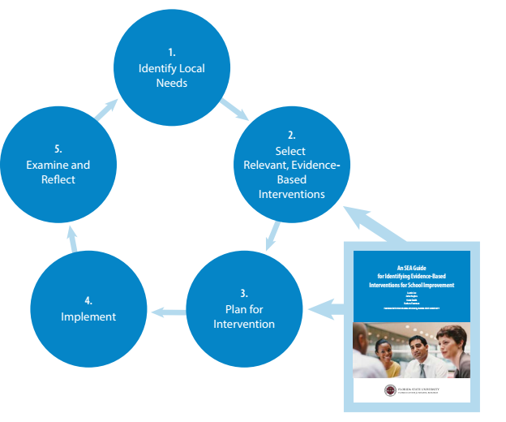
Considering Context
Notes:
3 min. – Explain to the participants that the ESSA guidance recommends that a continuous school improvement model be implemented. This model involves first assessing the needs of the school – which is required by ESSA. The guide helps in the selection of evidence-based interventions; however, the needs of the school must be considered. In addition, the guide helps the team think about initial planning for implementation.

Slide 13
Considering Context
ESSA requires that a needs assessment be conducted to determine issues that should be addressed at schools in need of targeted and comprehensive support.
Interventions that are selected for use in schools needing improvement should be those that address the issues identified in the needs assessment, have the highest evidence-level possible, and be those that the school has the feasibility to implement and sustain.
Notes:
1-2 min – Note that the interventions need to be appropriate and doable, although the team will want to consider providing resources to assist with implementation is possible.

Slide 14
The Self-Study Process

Slide 15
What is Self-Study?
Self-study provides a structure for collaboration and decision-making. The process involves establishing a team of stakeholders and using a guide with predetermined focus areas and questions to collect, share, and discuss information. It may also provide an opportunity for team members to suggest additional focus areas for consideration.
Notes:
1-2 min. – Explain the self-study process as described on the slide. This process simply provides the structure for a facilitator to lead a team of stakeholders as they thoughtfully consider options and engage in decision-making.

Slide 16
The Self-Study Process – Recruiting a Team
Identifying a Self-Study Team - It is preferable to invite people with a wide variety of background and roles to be a part of the team.
Discuss the following questions at your tables and be ready to share your thoughts with the whole group:
Why would it be important to include a wide variety of participants?
What kinds of team members would you include, considering that you are making decisions regarding school improvement interventions?
How many team members do you think would be appropriate?
What characteristics should team members possess considering that they will be doing both individual and collaborate work?
Notes:
7 min. (approximately) – Review the slide with the participants and ask table groups to discuss the questions. One person should jot down notes for each question so the table group is prepared to share if called upon. Ask different table groups to share the highlights of their conversation regarding each of the questions.

Slide 17
The Self-Study Process – The Role of the Facilitator
Facilitators have an integral role in the success of the self-study process. You may have been chosen as a potential facilitator by leadership in your organization, or a self-study team that has already been established may have selected you.
The responsibilities of the facilitator include:
Organizing and distributing documents associated with the self-study including the guide itself
Instructing the team members in how to engage in individual work that may involve completing the scoring template and scoring guide
Leading discussions
Scheduling meetings
to review the guide
for voting, collaboration, and planning after individual work has been done
For subsequent follow-up as necessary
At your tables, chart characteristics of a good facilitator taking into account the responsibilities above.
Notes:
5-7 min (approximately) – Review the responsibilities of the participants in their roles as facilitators. Ask the table groups to discuss the characteristics of a good facilitator and list them on chart paper. Post the charts around the room so they can be referenced later.

Slide 18
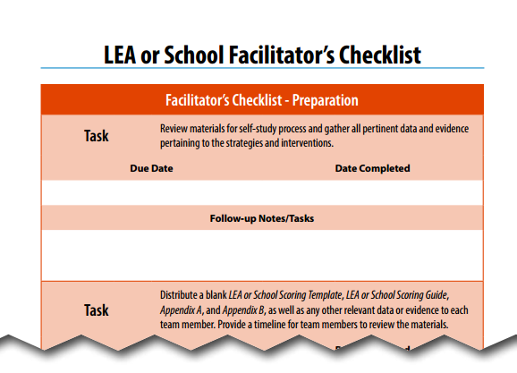
The Self-Study Process – The Role of the Facilitator
The Facilitator’s Checklist (pg. T-10) may help the facilitator keep track of tasks that need to be completed:
Notes:
1 min – Call attention to the fact that this is in the guide as a resource for facilitators.

Slide 19
Conducting Self-Study

Slide 20
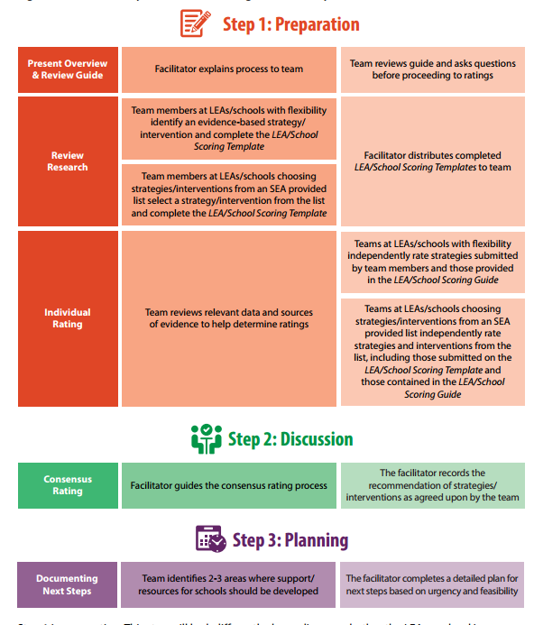
Steps in Self-Study
Notes:
1-2 min – Review this graphic with the participants. It is included in the guide (pg. 4) and provides an overview of the self-study process utilizing the guide.

Slide 21
SEA Guide for Identifying Evidence-Based Interventions for School Improvement
Notes:
5 ½ min. – If the participants will facilitate a state level team, explain that this video overviews the self-study process using the guide, and then show the video. Reflect that the remaining time in the session will be spent helping them to learn to guide the process by becoming familiar with the guide and their role as a facilitator. The link to the video is: https://youtu.be/eVhSXN6DYC4.
*Skip this slide if the participants will be working with district or school level teams.

Slide 22
LEA Guide for Identifying Evidence-Based Interventions for School Improvement
Notes:
5 ½ min. – If the participants will facilitate a district or school level team, explain that this video overviews the self-study process using the guide, and then show the video. Reflect that the remaining time in the session will be spent helping them to learn to guide the process by becoming familiar with the guide and their role as a facilitator. The link to the video is: https://youtu.be/6-rbJK0HUtA.
*Skip this slide if participants will be working with state-level teams.

Slide 23
Step One of Self-Study - Preparing for Collaboration
Individual Work for the Facilitator
Schedule meeting with team members to review the guide
Distribute documents to team members
Schedule meeting following individual team work
Individual Work for Team Members
Review the Guide, reading carefully the section on collecting and evaluating research
Search for and identify a school improvement intervention to present to the self-study team for consideration
Collect and evaluate the evidence-base of the intervention
Formulate questions that may help team members thoughtfully consider the intervention
Cite the research gathered
Individually rate evidence-based interventions provided by the facilitator as “not recommended,” “recommended,” or strongly recommended
Note any questions to bring to the team meeting
Notes:
1-2 min. – Note that there is individual work for both the facilitator and the team members. The participants need to be prepared to answer questions if they are asked by team members; therefore, the participants need to be comfortable with the self-study process as well as the contents of the guide.

Slide 24
Step Two of Self-Study – Participating in Discussion
Team members share their rankings of school improvement interventions as “not recommended,” “recommended,” or “strongly recommended.”
The facilitator guides a discussion following the vote in an effort for the team to come to consensus regarding each of the interventions.
Notes:
1-2 min. – Note that the participant’s role as a facilitator role is critical in conducting the discussion, ensuring that everyone has the opportunity to participate, that no single person dominates the conversation or decision-making process, and that the team considers interventions in a thoughtful and comprehensive manner.

Slide 25
Step Three of Self-Study – Planning Next Steps
The facilitator leads a discussion regarding planning for next steps, recording priorities and ideas of the team along with any anticipated challenges.
Timelines for follow-up are established and future meetings are established.
Notes:
1-2 min. - Emphasize to the participants that their role as facilitator is critical to this discussion and helps to clarify priorities, establish next steps, timelines and responsibilities, and schedules meetings to be sure that goals are being accomplished.

Slide 26
Exploring the Guide and the Role of the Facilitator

Slide 27
Exploring the Guide and the Role of the Facilitator – An Overview
Narrative Sections
Table of Contents
Introduction
The Self-Study Process
Overview of the Self-Study Guide Tools
Preparing for Self-Study
Follow-up, Monitoring, and Evaluation
Self-Study Tools
Checklists for Team members and Facilitators
Scoring Template
Scoring Guide
Voting and Consensus Rating Form
Planning Form
Notes:
5 min – Encourage the participants to thumb through the guide as the sections are mentioned. Emphasize that they will need to become very familiar with the guide if they are to effectively facilitate. They will need to be able to explain the components of the guide and answer questions from team members. We will spend time with the meat of the guide in this session, but they will need to spend time with the entire guide on their own.
Point out that the “Preparing for Self-Study” section contains some especially important components including sections that address collecting and evaluating research and explanations of the levels of evidence. Emphasize that team members will need to read these sections carefully so they can conduct the independent work in preparation for team discussion. Emphasize to the participants that as facilitators they will need to call attention to this section in particular when reviewing the guide initially with the team.
Note that the tools are all fillable electronically. Participants in their roles as facilitators will need to decide which tools they will utilize and instruct their team members to use.

Slide 28
Exploring the Guide and the Role of the Facilitator – Sections for Preparation
Team members may need to use the following sections to conduct independent work before meeting for discussion:
Preparing for Self-Study
Checklist
Scoring Template
Scoring Guide
Appendix A – Annotated Bibliography
The facilitator will need to decide if all of the components will be utilized by team members, or if only some of them are appropriate to their needs.
The facilitator may also wish to use the Facilitator’s Checklist to ensure all tasks are completed.
Notes:
2-3 min – These sections are particularly important in getting the work started. Have the participants tab them with sticky notes. Explain to participants that in their role as facilitators they will need to be sure that team members understand the self-study process and the independent work they will need to do to prepare for the discussion phase.

Slide 29
Exploring the Guide and the Role of the Facilitator– Sections for Preparation: Collecting and Evaluating Evidence
At your table:
In the Preparing for Self-Study section, read the information concerning the process, collecting research, and evaluating research. Discuss the following questions:
Are the characteristics of a good facilitator listed in the guide reflective of those that your group listed?
How does the facilitator seem to keep the process flowing?
Are there other resources that you know of where research to identify evidence-based interventions might be found? If so, write them on sticky notes.
Are there other organizations that you know of that could help in the evaluation of research? If so, write them on sticky notes.
Notes:
7-10 min – Instruct participants to read these sections and table groups to discuss the questions. If the groups identify resources and organizations that are able to assist with collection or evaluation of evidence-based strategies, ask that they be written on sticky notes and then collect those and post them on chart paper.
*If there is time and internet access, allow participants to visit some of the websites so they can familiarize themselves with the resources that are available. This will add time to this activity.

Slide 30
Exploring the Guide and the Role of the Facilitator – Sections for Preparation: ESSA Levels of Evidence
In your groups:
Everyone read the section on the ESSA levels of evidence on pages 13-14.
Discuss the following questions:
What is meant by “statistically significant”?
What is meant by “substantively important”?
Why are these important?
Why is context of the studies important?
Why can “demonstrates a rationale” be considered an opportunity for building evidence?
Notes:
7-10 min. – Stress to participants that they need to have a good understanding of these concepts so they can answer questions from their team members. Ask groups to each read the section on ESSA evidence levels and then to discussion the questions on the screen.

Slide 31
Exploring the Guide and the Role of the Facilitator – Sections for Preparation: ESSA Levels of Evidence
In your groups:
At least one person reads the section on strong evidence (pgs. 14-16)
At least one person reads the section on moderate evidence (pgs. 16-17)
At least one person reads the sections on promising evidence and evidence that demonstrates a rationale (pgs. 17-18)
After reading:
Explain the section you read to your group. Be sure to note the critical components of studies falling into the evidence-level, what constitutes being “well-designed and well-implemented,” and some “look-fors” that reflect the evidence-level you read about.
Notes:
15-20 min. (approximately) – Utilize the jigsaw strategy as described on the slide so that everyone gains an understanding of the material. Participants at each table should read a different section of text and then explain that section to everyone else at the table. If there are enough participants at a table, allow more than one person to read a section and discuss it with their partner before they explain it to the others at the table. Explain that it would be particularly helpful if at least two people read the section on strong evidence and explain that section it to the group together.

Slide 32
Exploring the Guide and the Role of the Facilitator – The Scoring Template
With a partner at your table:
Review the data from ABC Elementary School and determine a top priority in the school.
Select one of the interventions found on one of the websites (pg. 12) that you think addresses the priority of the school you identified, and has an evidence-base that satisfies your group.
Work together to complete the scoring template, except for the selection of the rating. Your group will need to think about what additional information might be available to help evaluate the intervention, and develop at least two guiding questions that might help others as they consider whether this is an appropriate choice for the school.
Notes:
30 min. (approximately) – Reflect to participants that this activity will give them insight, as facilitators, into collecting evidence and evaluating it considering the needs of the school. It also provides some awareness into the challenges involved.
Instruct the participants to review the data (spreadsheet and narrative) from ABC Elementary School carefully. Table groups should determine two or three top priorities based on the data. They should then choose one to address with an intervention.
*The completed scoring templates will be used in a subsequent activity; however, if no internet connection is available, you may want to walk through an example in the scoring guide in areas 2-5 (Area 1 will be used for an upcoming activity as well). Encourage participants to note the information that may be considered and the guiding questions. This activity will take less time if participants are not actually completing the activity but are receiving an overview.

Slide 33
Exploring the Guide and the Role of the Facilitator – Sections for Preparation: The Scoring Guide
Individually, read through the interventions in Area 1, Implementing Systemic Change (pgs. T-20 toT-25). Consider the needs assessment of ABC Elementary School and the evidence-level of these interventions.
Reference Appendix A. Annotated Bibliography (pg. A-1) for additional information regarding the research.
Rate each intervention as “not recommended,” “recommended,” or “strongly recommended.”
Notes:
15 min. (approximately) – Explain to participants that in their role as facilitators they may be asking team members to do this work. Reflect to the participants that they may ask their team members to rate all of the interventions in the scoring guide, some of them, or none of them depending on the state and local situation.

Slide 34
Exploring the Guide and the Role of the Facilitator – Discussion and Planning
At your tables review the following documents that are used to record the thoughts and ideas of the self-study team members:
Initial Voting Worksheet (supplemental document)
Consensus Rating Form (pg. T-47)
Planning Form (pg. T-50)
Notes:
2-4 minutes – Review these documents with the participants and talk about how they are used. Indicate that the preceding slides provided participants with an idea of the work that would be required of team members. Point out that these documents are those that they will use as facilitators to capture the ideas of team members.
Initial Voting Worksheet – used to capture the first vote of each team member
Consensus Rating Form – used to record the consensus vote of the team
Planning Sheet – used to record priorities, ideas for resource development, challenges or other thoughts of the team related to planning for implementation.

Slide 35
Exploring the Guide – Discussion, Planning and the Role of the Facilitator
Each table group shares out two characteristics of a good facilitator from the charts created earlier.
Brainstorm at your tables:
What are examples of ways the facilitator can encourage the conversation?
What can the facilitator do to ensure that one or two team members do not monopolize the conversation?
What can the facilitator do to involve team members who are not as comfortable sharing their opinions?
How can the facilitator ensure that he or she captures the thoughts and ideas of the team members accurately?
Notes:
15 min. (approximately) – Ask groups to share out a couple of characteristics they charted earlier to their refresh memories. Ask the participants to talk about the questions on the slide and to jot down answers that they can share out in whole group.

Slide 36
Practicing the Role of the Facilitator
Take turns practicing facilitation using the completed scoring templates and the completed scoring guide for the interventions in Area 1. Each person at the table will facilitate the conversation pertaining to ONE intervention.
The facilitator records the initial votes of team members using the initial scoring worksheet.
The facilitator leads the discussion – ask team members to explain why they voted the way they did. Attempt to reach consensus
Conduct a consensus vote using the Consensus Rating Forms
Work through two questions on the Planning Form
Notes:
30-45 min (approximately) – Ask everyone to locate the scoring template and scoring guides that they completed earlier. Instruct each person at the table to take turns facilitating the discussion regarding ONE intervention. Explain that the participant who is facilitating should take an initial vote using the voting worksheet, lead the discussion, and then record results on the Consensus Rating Form. He or she will then lead the team as they discuss two questions on the Planning form. Circulate while the table groups are engaging in this activity to answer any questions and provide support.

Slide 37
Reflection and Summary

Slide 38
Reflection
At your tables discuss:
What went well?
What will you need to practice?
What did you learn?
Notes:
5-7 min – After teams are finished with the preceding activity ask them to debrief, discussing the questions on the screen.

Slide 39
Reflection
Whole Group Discussion:
What are the overall benefits of this process?
Why is it helpful to have a structure when engaging in this work?
Why is it beneficial to have team members who hold a variety of roles and have expertise in different areas?
What are next steps when I return to my agency, district, or school?
Notes:
5-7 min. – Engage the participants in a brief discussion regarding the questions on the screen. List the overall benefits on chart paper if there is time.

Slide 40
In Summary
ESSA provides flexibility and responsibility to states and school districts to select interventions for their schools in need of comprehensive or targeted support.
The Guide for Identifying Evidence-Based Interventions for School Improvement and the self-study process provide a structure to help in the decision-making process.
The guide encourages the selection of interventions that meet the needs of the school and are evidence-based.
Both individual and group work are a part of the process.
The facilitator is critical to the implementation of the guide.
Notes:
2 min. – Reference the bullets on the screen summarizing the content of the session.

Slide 41
Resources and Contact Information
The guide and resources that support it may be found at: http://essa.fsu.edu
For additional information regarding the guide or its use please contact:
Laurie Lee
Florida Center for Reading Research
llee@fcrr.org
850-644-1953
Notes:
1-5 min – Indicate to the participants that they may go to the website to access the guides and to view other ESSA resources. If there is time and an internet connect, go to the website and show the participants some of the resources. Explain that they may also contact Laurie Lee from the Florida Center for Reading Research if they have questions or comments regarding the guide or any of the resources.

